Slide 1
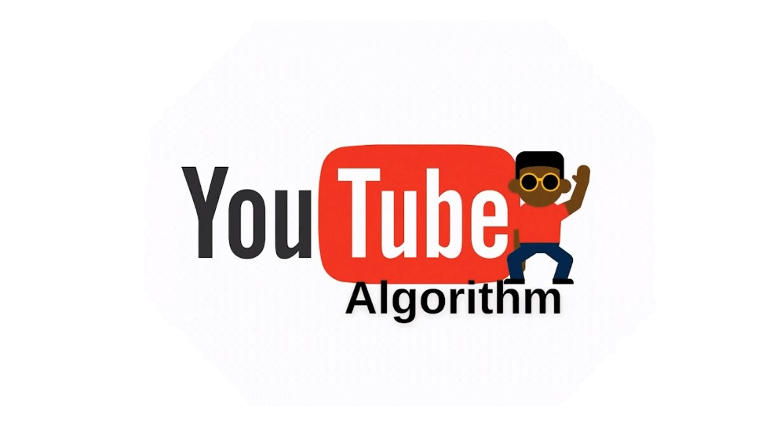

Slide 2


Meet The Team.
Abhishek Raman (5)
Adithya Krishnan (8)
Adlu Rahman (9)
Augustine Reji (17)
Bharath S Ram (18)
Joel Ipe Samuel (27)
Ezek Varghese Prasad (21)

Slide 3




Contents
YouTube .
YouTube algorithm .
History of YouTube Algorithm.
How does the YouTube algorithm work?
Factors Affecting the YouTube algorithm.
YouTube Algorithm and Creators.
Privacy On YouTube.
Impact on our lives

Slide 4


YouTube
YouTube is an American video sharing and social media website/platform owned by Google. It was founded by Steve Chen, Chad Hurley and Jawed Karim on February, 14, 2005. In the current age of the internet, YouTube is considered to be giant in the online video industry is also in fact the second most searched website after Google. This goes to show that the website has a huge audience to tune in to. Yet the astounding facts about this website come pouring in. There is an estimated billion hours’ worth of videos being watched by people every day. But among all of billions of videos, how can know what is useful to us? That’s where the YouTube Algorithm comes into play.

Slide 5
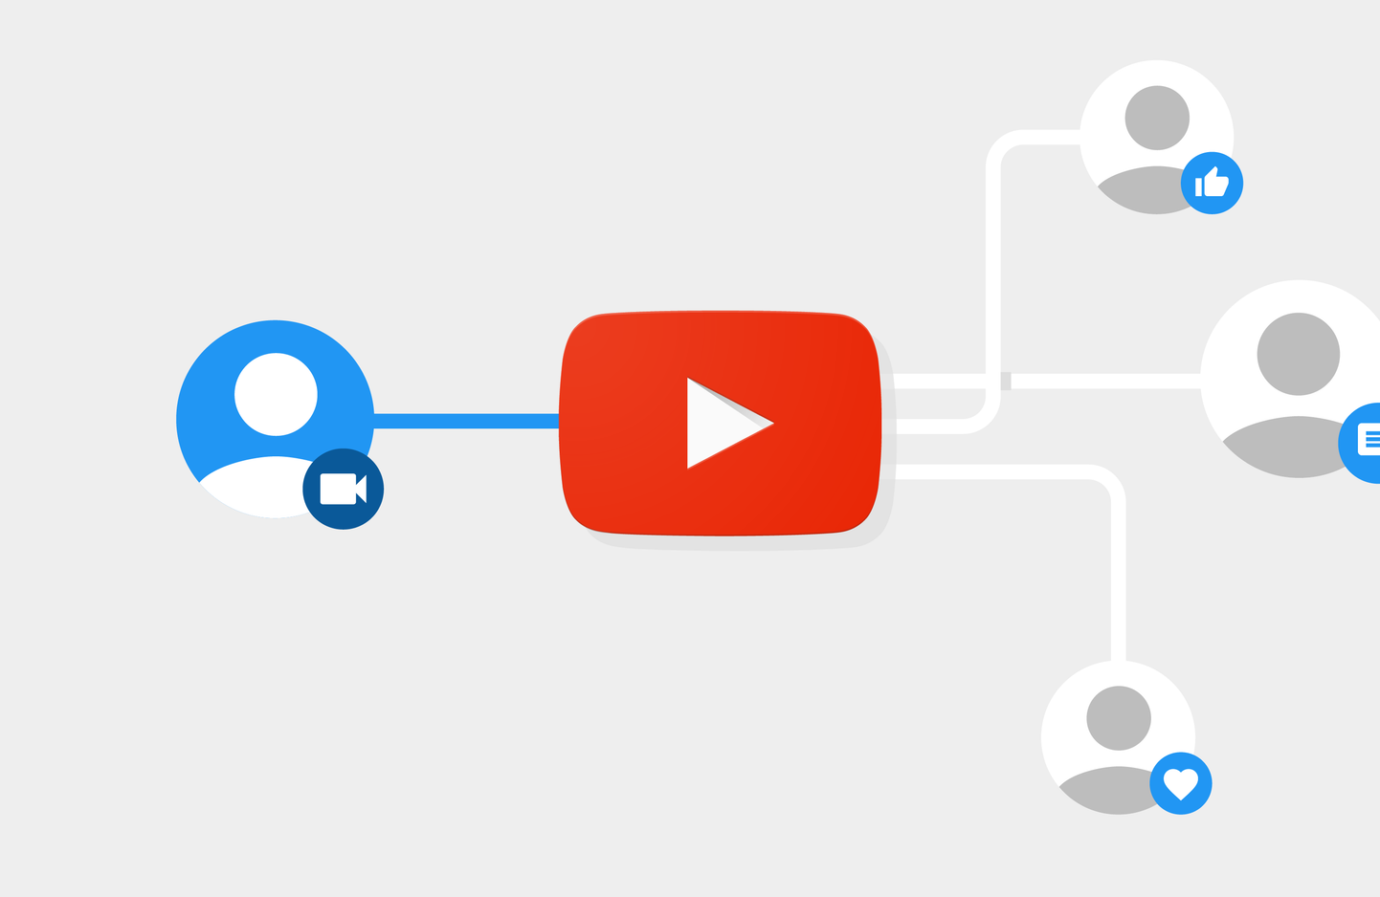
YouTube Algorithm
The YouTube algorithm is one of the most sophisticated algorithms. The algorithm track all the actions performed by the user inside the app/ website, such as what kind of videos the user likes to watch. The algorithm works on a real-time feedback loop that will categorize the videos for each user on the basis of their interest and their previous activities.

Slide 6

History of YouTube Algorithm
Looking back on the history of the Algorithm, the platform rewarded videos that got clicks. So back in the era of 2005-2012 YouTube, the Algorithm was more insistent on people tuning into videos and because of this shallow parameter, creators started to “clickbait” viewers into clicking their videos. This meant creators were putting fake and false titles and thumbnails in order to pique the interest of the viewer. After 2012, the YouTube changed to the system of vie duration, where the amount of view time a user watched of a specific channel was being recorded. This turned to be a good decision on YouTube’s part because since they were recording viewer attention and retention, the overall amount of time a user spent on the platform increased drastically.

Slide 7
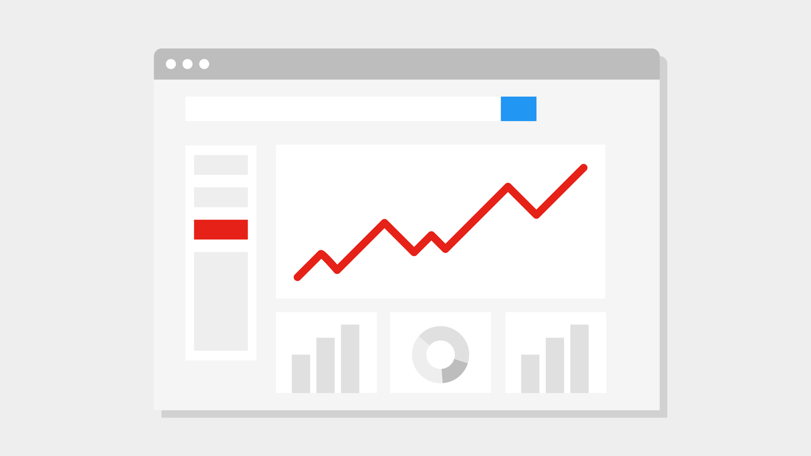
How does the YouTube algorithm work?
The YouTube algorithm works on the past activities of the user and provides more and more videos related to the interest of the user. The YouTube algorithm categorizes the videos based on the YouTube channel the user likes to watch, the types of videos the user watch, likes and dislikes on the videos. There is one factor on which the YouTube algorithm focus most is the engagement time of the user on each video.
Search
Home and suggested videos
Trending
Subscriptions

Slide 8
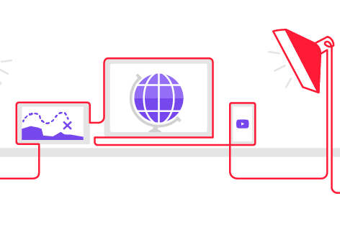
Factors Affecting the YoutTube Algorithm
There are some factors that affect the youtube algorithm while choosing the video for any user that is given below:
The type of videos users regularly watches, such as if the user likes to watch fashion videos and spent most of the time watching fashion videos, then the youtube algorithm tries to provide more and more videos related to fashion.
The amount of time users spent watching a particular type of video.
How often does any channel upload new videos?
The session time user spent on youtube
Engagement of user with the video such as giving like or dislike to any video, giving feedback to the video whether it is positive or negative.

Slide 9
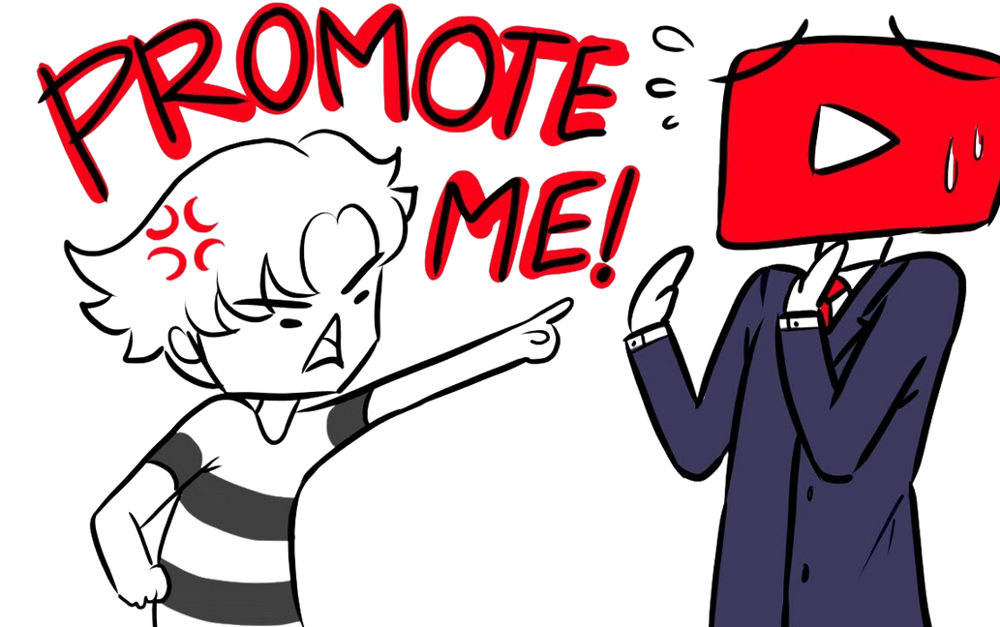
YouTube Algorithm and Creators.
But let’s say, as a creator, how does one go about making a video appropriate the website’s parameters? Some of the ways to improve on this front are:
Adhering to YouTube’s guidelines.
Perfect your thumbnails and titles.
Stick to a consistent posting schedule
Optimize your video description text.
Try to add accurate subtitles to the video.
Add keywords that are readable and easy
to understand.

Slide 10

Privacy On Youtube.
The way YouTube's algorithm keeps recommending videos according to our likes and dislikes is by recording your watch history so as to recommend the user similar videos. This mostly also resembles cookies on a website. Just like the privacy breach from Facebook in 2018, companies and organizations that control and lead these websites, could fall victim to data leaks and privacy breaches, which hurts their reputation incredibly.

Slide 11
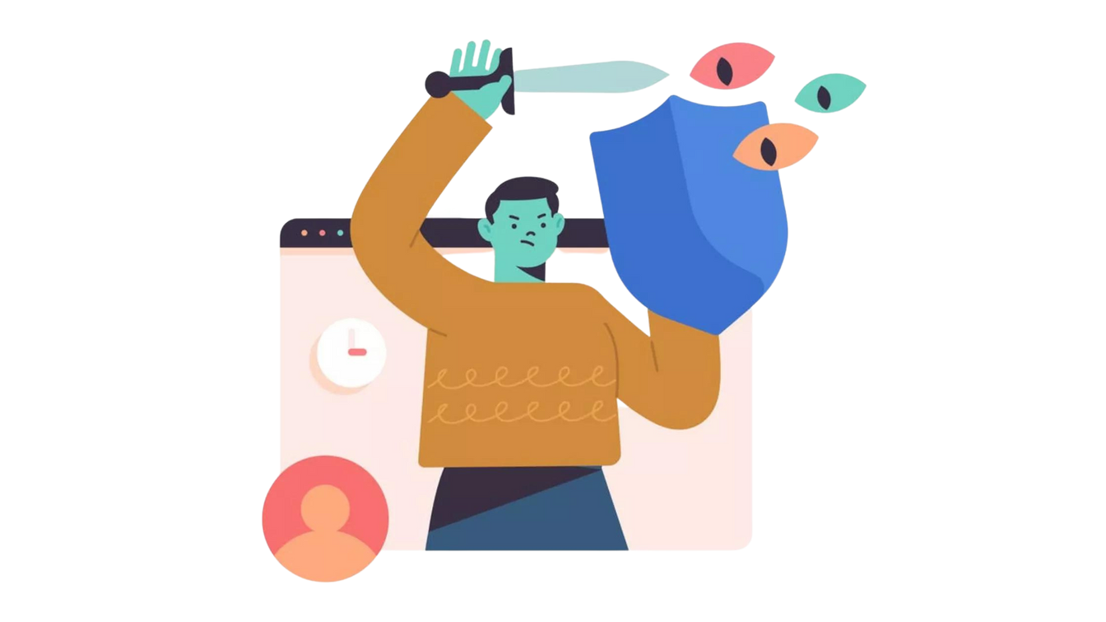
To prevent this, hearing the viewers’ requests is one of the pillars of customer feedback. Improving on the system is something every company or business should do and YouTube doesn’t fail on that. It tries to improve something. If it’s not well received, they could also try something else that sticks. Transparency should be crystal clear on this kind of matter.

Slide 12
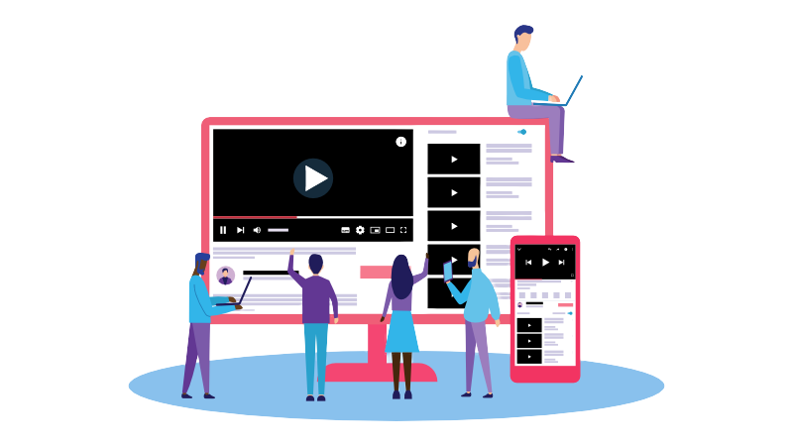
Impact on our lives
Thanks to online tracking technology, marketers no longer have to rely on assumptions about consumer behavior. Instead, they can deliver ads targeted specifically to individuals based on their behavior online.
YouTube has become an important "visual journalism" platform, both for conventionally produced content from established news organizations and for citizen eyewitness contributions. Certain independent or alternative news organizations have established YouTube channels that reach a wider audience than traditional broadcast television.

Slide 13
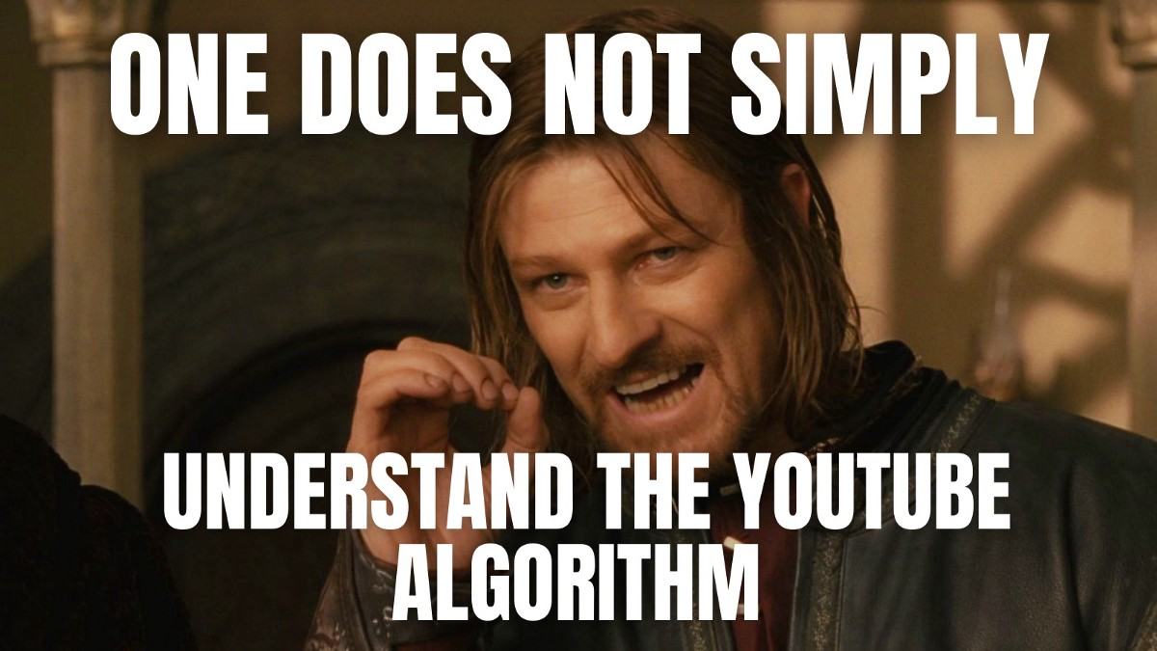

Slide 14

Thank You.

